Slide 1
28 OCTOBER, 2023
Presentation for CCCI

Slide 2

आपको वही मिलता है जो आप देते हैं, चाहे वह बुरा हो या अच्छा।

Slide 3

ELITE FAMILY OFFICE

Slide 4
TOPIC:
SECOND INCOME THROUGH FINANCIAL MARKETS

Slide 5
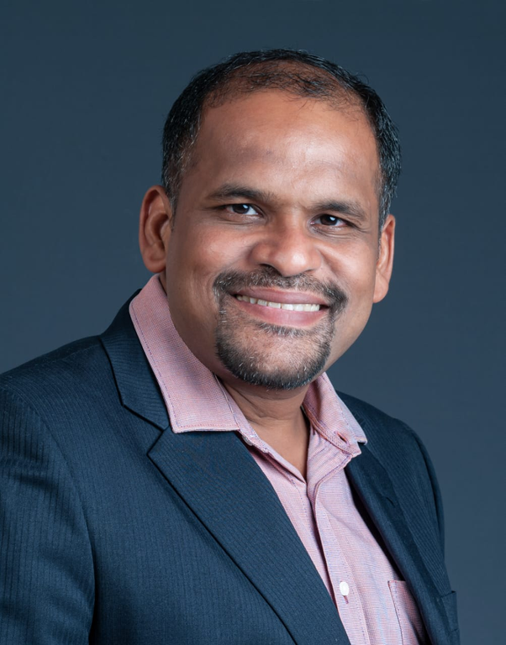
About Myself
Name: Savio Varghese
Education Qualification:
B.COM, Masters in Marketing Management.
NISM Certified (AMFI), IRDA Certified,
Retirement Readiness Certification (RRC)
Professional Experience :
•2016-2017: Morning Star India
•2010-2016: IDBI Mutual Funds
•2006-2010: Invesco Mutual Funds
•2005-2006: Cholamandalam

Slide 6




Where do we invest traditionally?

Slide 7
Where all can we invest?
Traditional Investment
and
New Investment Avenues

Slide 8
Pension
Income
Financial Assessment
Major Services
NRI
Investments
Retirement Assessment
Risk
Assessment

Slide 9
Insurance
Product Offerings
Fixed Income
SWP through Mutual fuds
Bonds

Slide 10
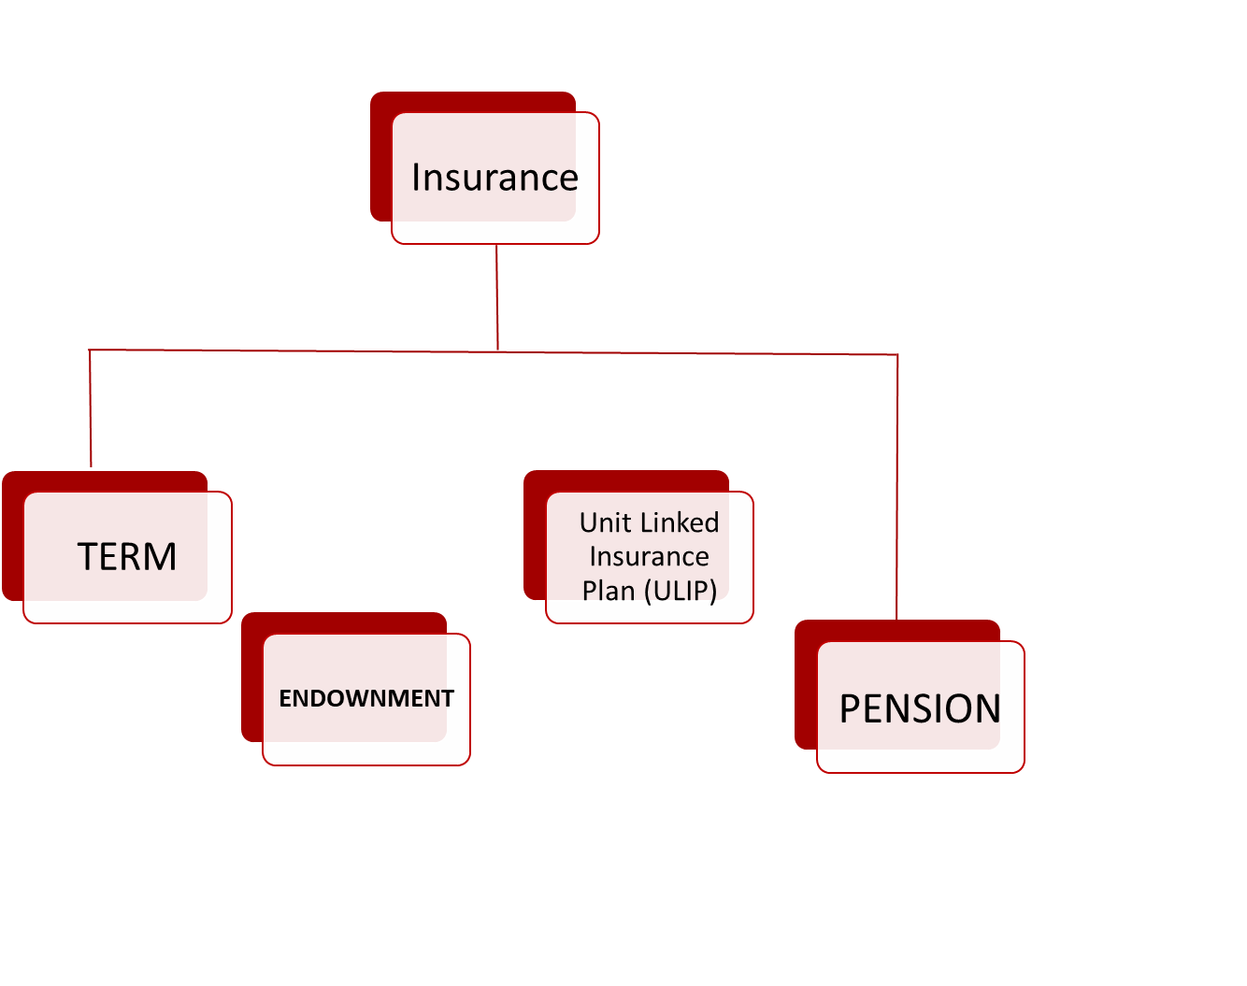

Slide 11
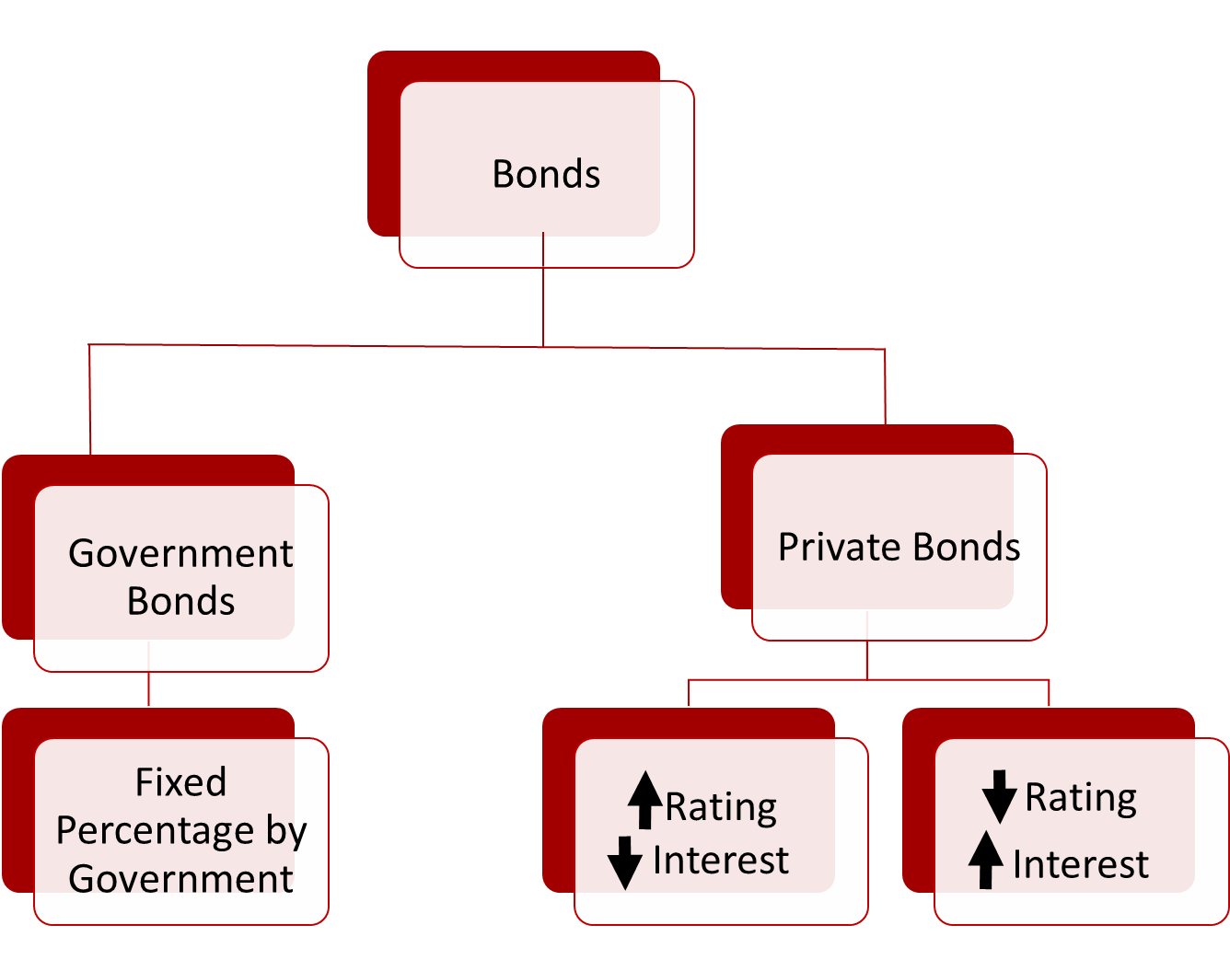

Slide 12




S.W.P through Mutual Funds
7%
8%
6%
Risk

Slide 13
QUIZ TIME

Slide 14



Be Cautious

Slide 15
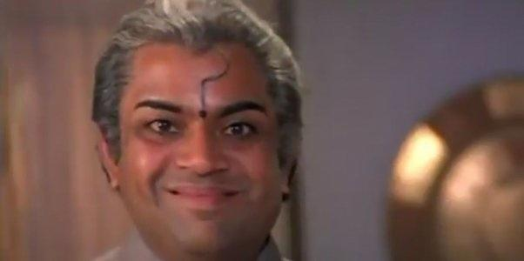
Ask Questions

Slide 16
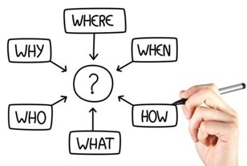
5W and 1H

Slide 17

" परिवर्तन दुनिया का नियम है !!! "

Slide 18

Insurance
Bonds
SWP through Mutual fuds

Slide 19
ThankYou

Slide 20
